Slide 1
Welcome Guests
Newark Morning Rotary
Discover Rotary Hour
November 2, 2022

Slide 2
What is Rotary?
It’s busy people,
just like you and me,
working to make life just a little bit better
for others here at home, and around the world.

Slide 3
Rotary is ...
Clean drinking water for people …
Vaccinations for millions of children …
Schools and books for children …
Health care for mothers and babies …
Peace and conflict resolution in communities …
Food on the table of families …
… that we’ll never meet.

Slide 4
Rotary In the World

Slide 5
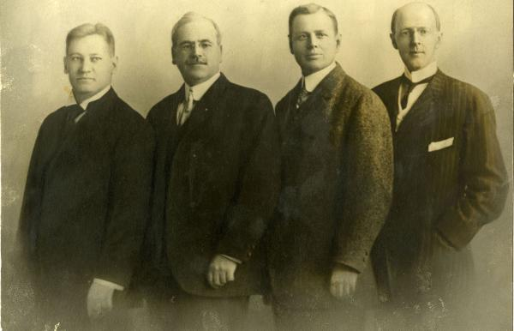
Our History – Paul Harris
Founded 1905 in Chicago
by Paul Harris (& friends)
Rotated meetings among member’s locations
1st project: Public Toilets

Slide 6
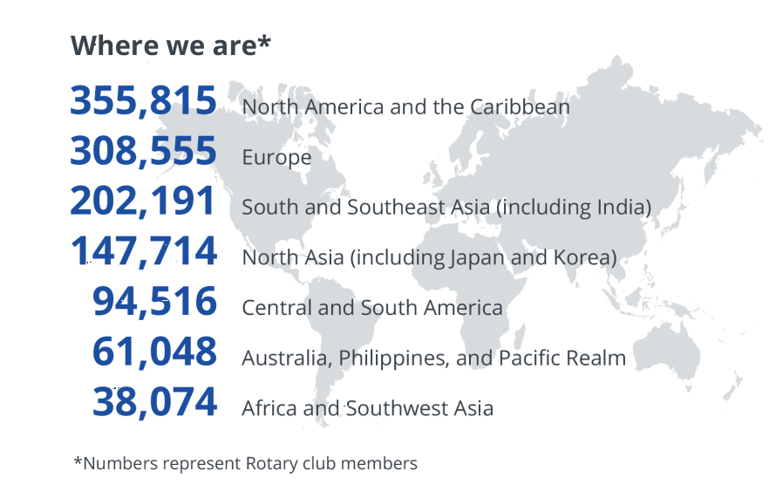
Our History – Rotary Today
1.2 million members
36,000 global clubs
nearly 200 countries
Notes:
6

Slide 7
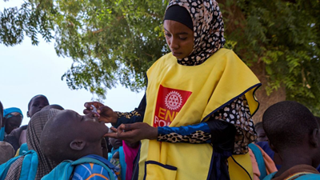
Our History – Polio Eradication
Working to eradicate Polio for over 30 years
1985: 1,000 cases per day (350,000 per year)
NOW: 33 cases in 2018

Slide 8
Our History - The Rotary Foundation
Rotary’s philanthropic arm
Started in 1917 with $26.50
Highest rating (4-stars) by Charity Navigator
Spent over $4 billion on life-changing projects

Slide 9
Our History – The Four Way Test

Slide 10
Newark Morning Rotary

Slide 11
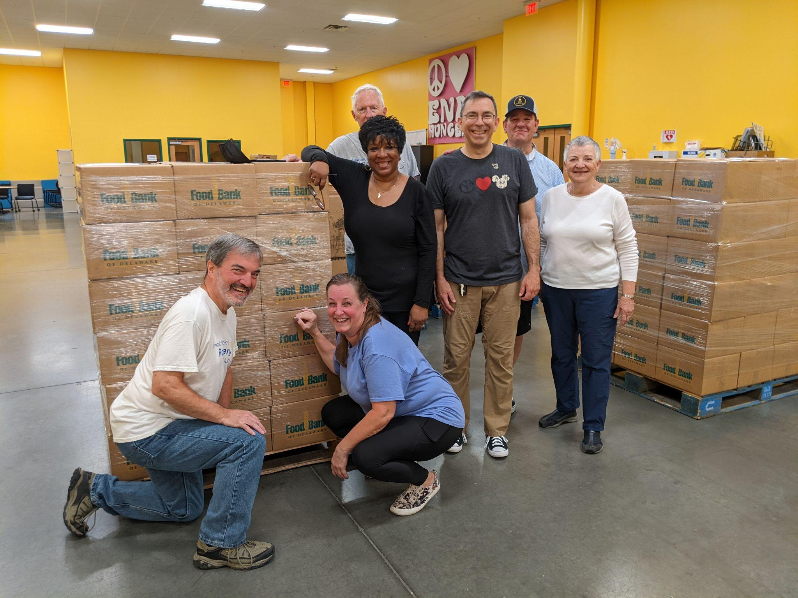
Newark Morning Rotary
Celebrated 20th Anniversary in 2019
42 members of varied interests and professions
Meet weekly on Thursdays from 7:00am - 8:15am

Slide 12
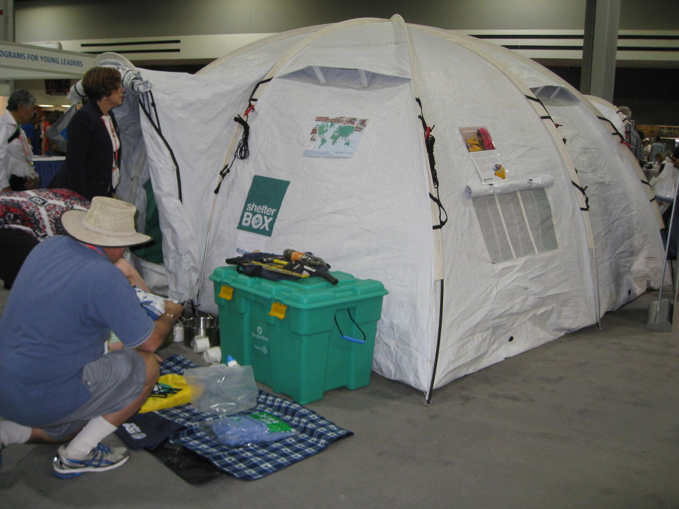
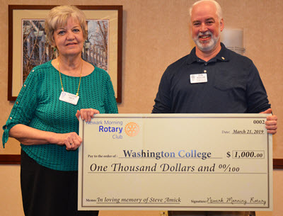
Dedicated to Serving the Community
We give money when vital …

Slide 13
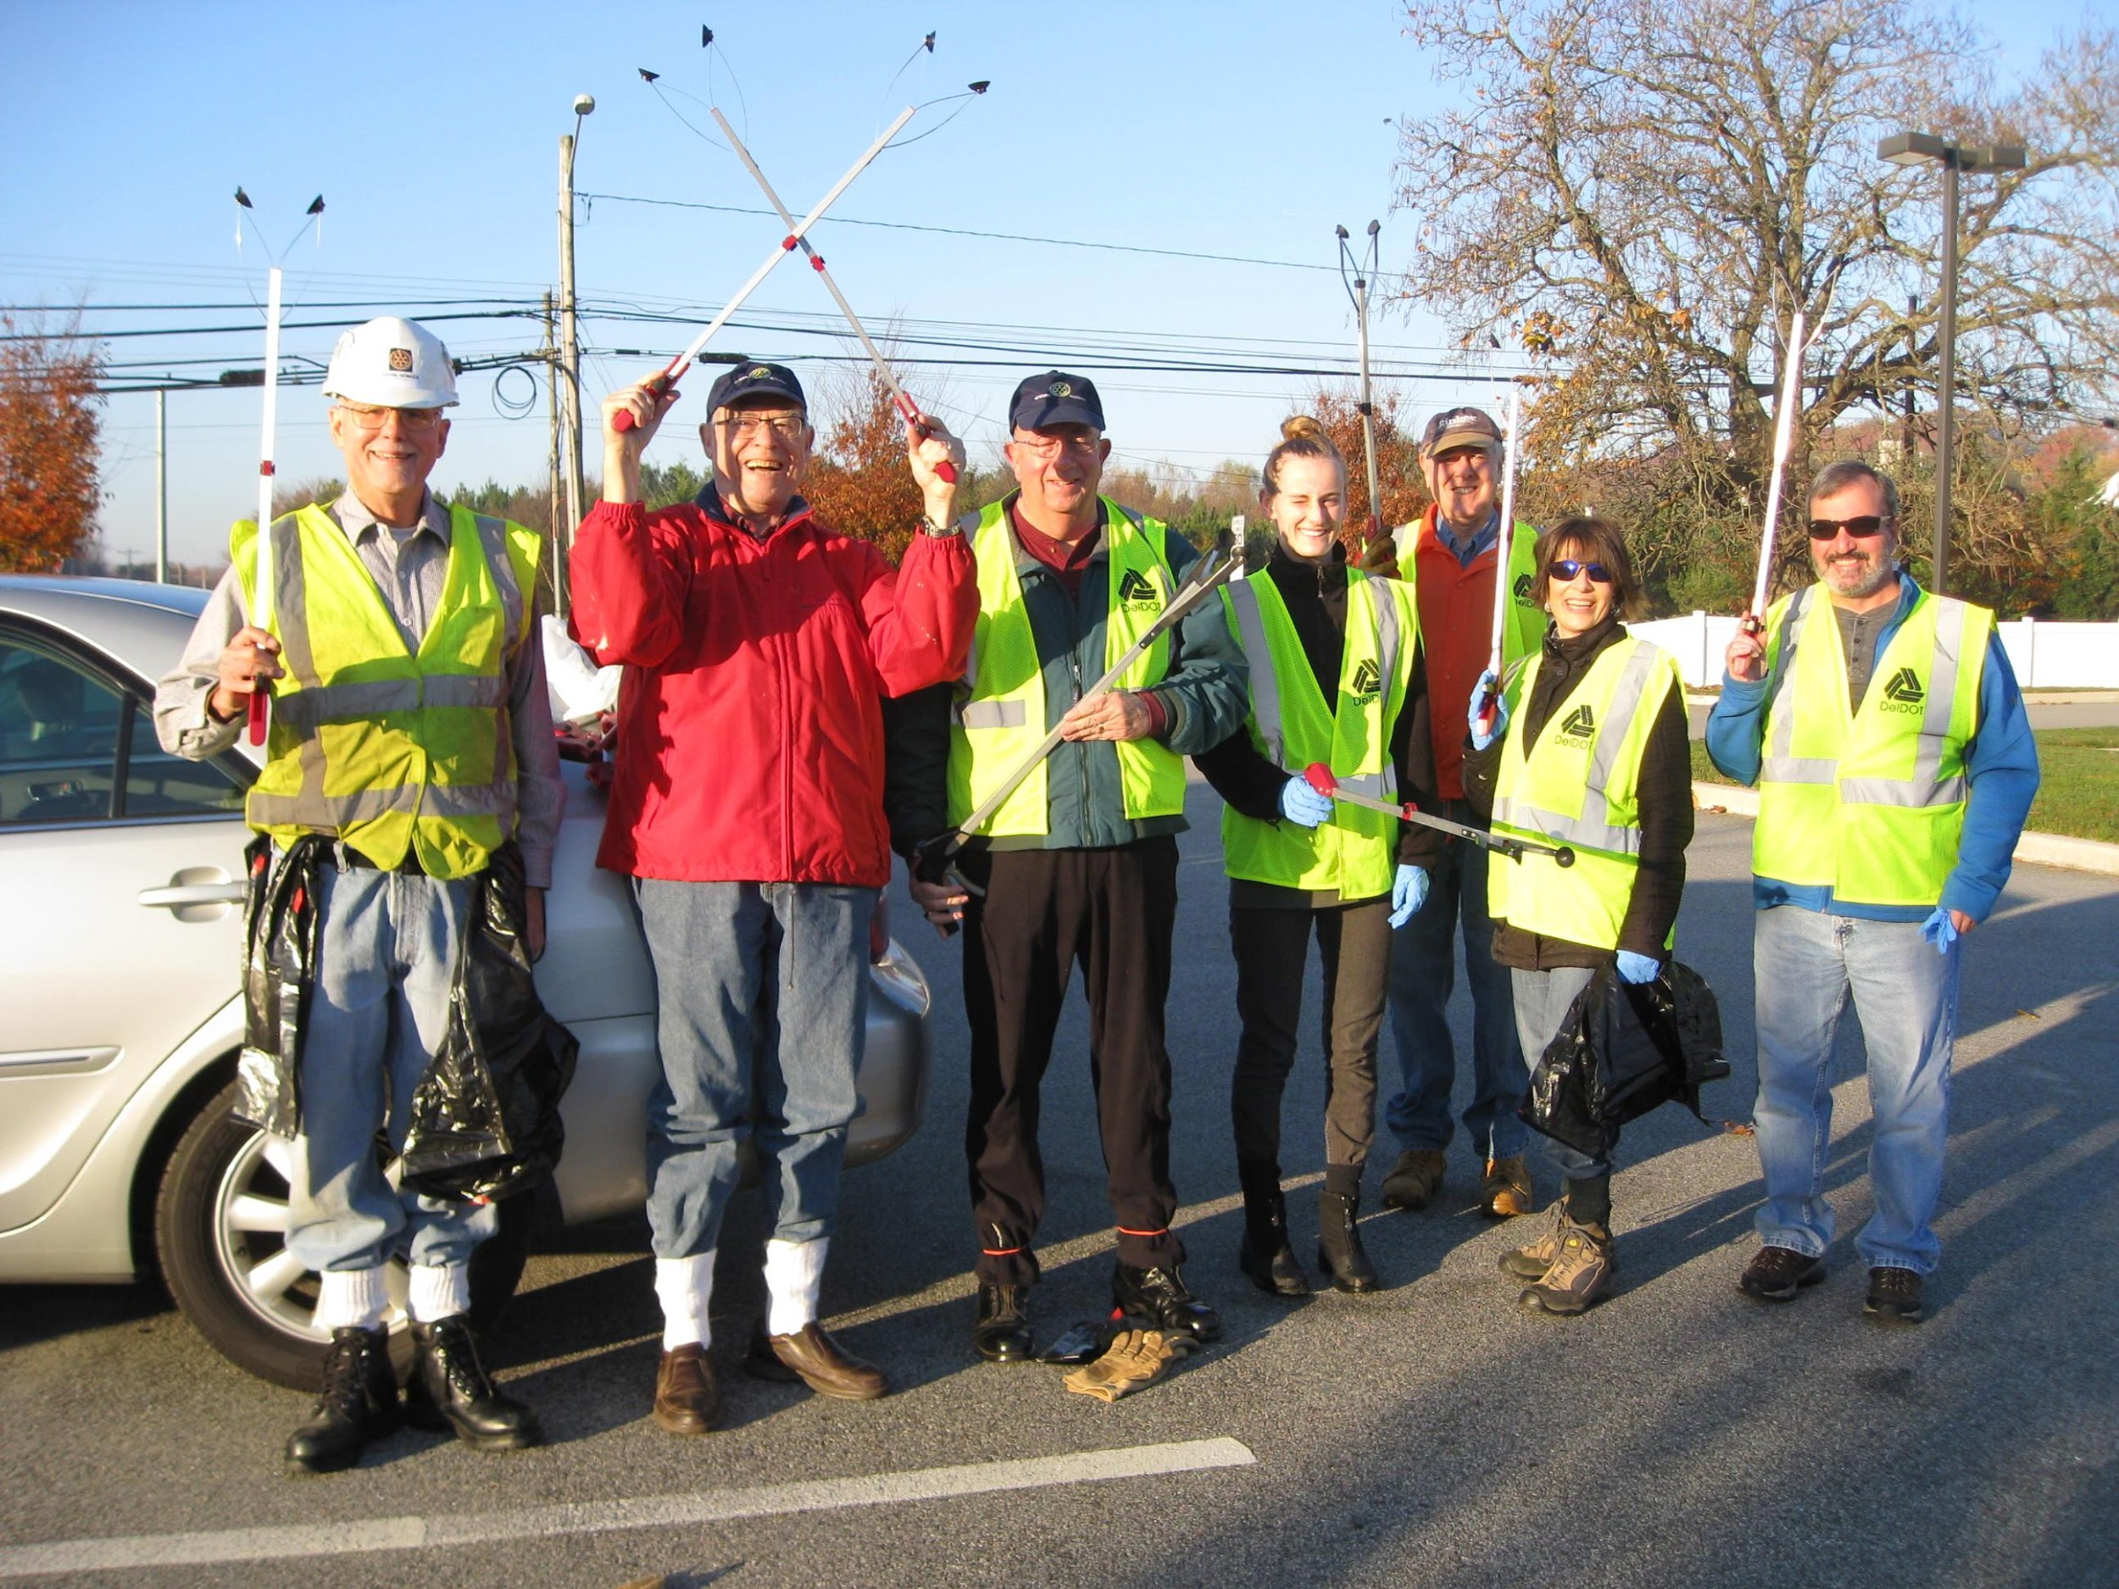
… and time when we can

Slide 14
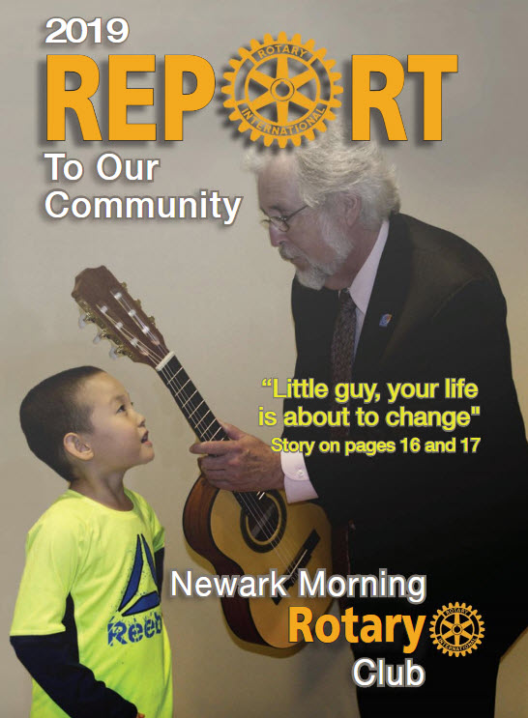
Report To Our Community
One HUGE fundraiser per year; Report To Our Community
Nearly $750,000 raised for community service projects
Money spent on humanitarian projects: Locally, Regionally, Globally
Not One Penny spent on ourselves

Slide 15
No raffle tickets, pizza kits, or bake sales

Slide 16
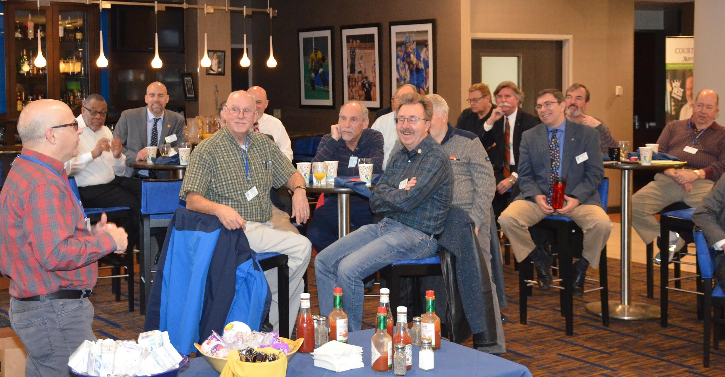
Newark Morning Rotary
Who are we at Newark Morning Rotary?
Men and Women, Ages 30 to 80
Working and Retired
40+ Members: Variety of Professions and Interests

Slide 17
We’re just like you …
Education
Engineering
Law
Real Estate
Financial Planning
Accounting
Business Owners
Clergy
Media
Elected Officials
Non-Profit
Hospitality
Communications
Retired
and more ...

Slide 18
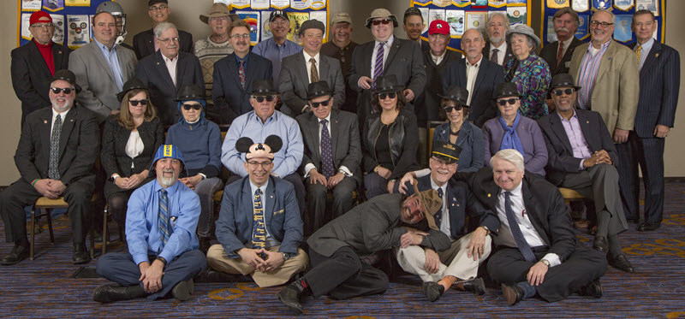
Newark Morning Rotary

Slide 19
Is This for Me?
Notes:
19

Slide 20
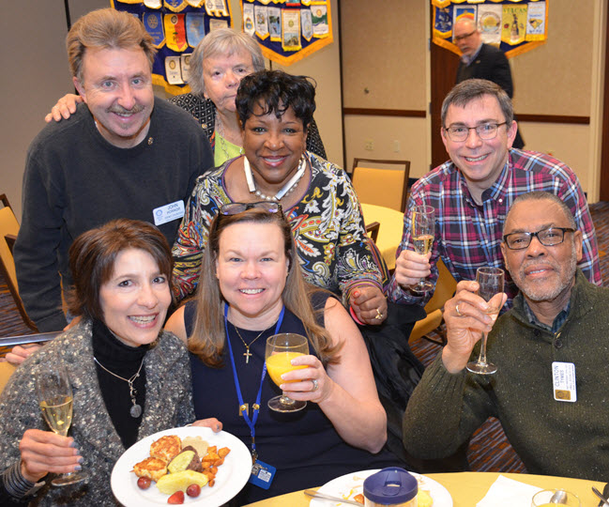
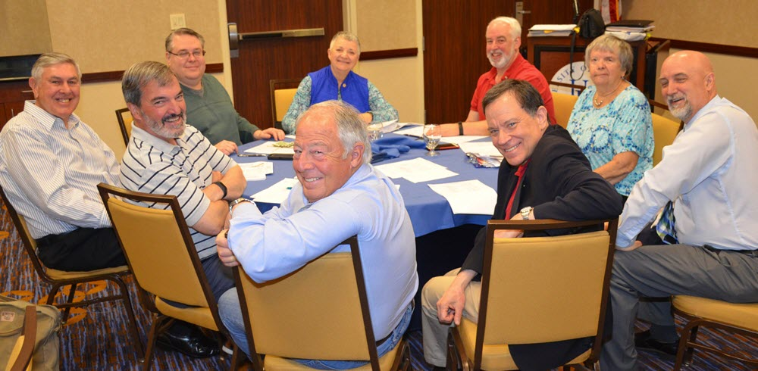
Is This for Me?
Thursday mornings
7:00 am to 8:15 am
Come dressed as you would for work
Notes:
20

Slide 21
Is This for Me?
Do you enjoy
working with others to solve problems?
helping those in need?
being part of something larger than yourself?
finding time to help when you thought you had none?

Slide 22
Is This for Me?
Membership Types
Regular
Corporate
Service
Student
Attend most meetings, standard fees
Shared attendance responsibilities
Attend 1 meeting per month, 26 Rotary service hours per year, reduced fees
Attend most meetings, 26 Rotary service hours per year, reduced fees

Slide 23
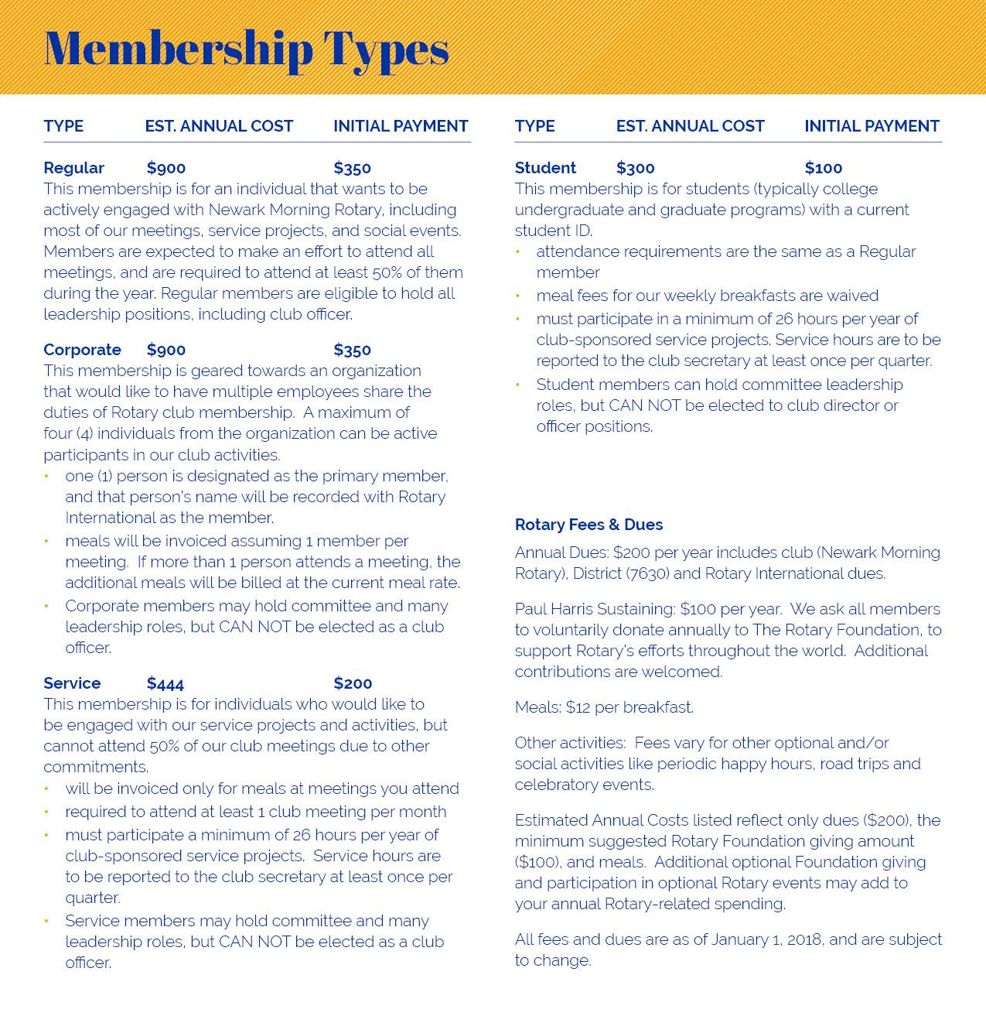
Is This for Me?
What does this cost?

Slide 24
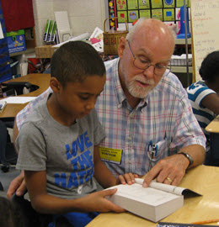
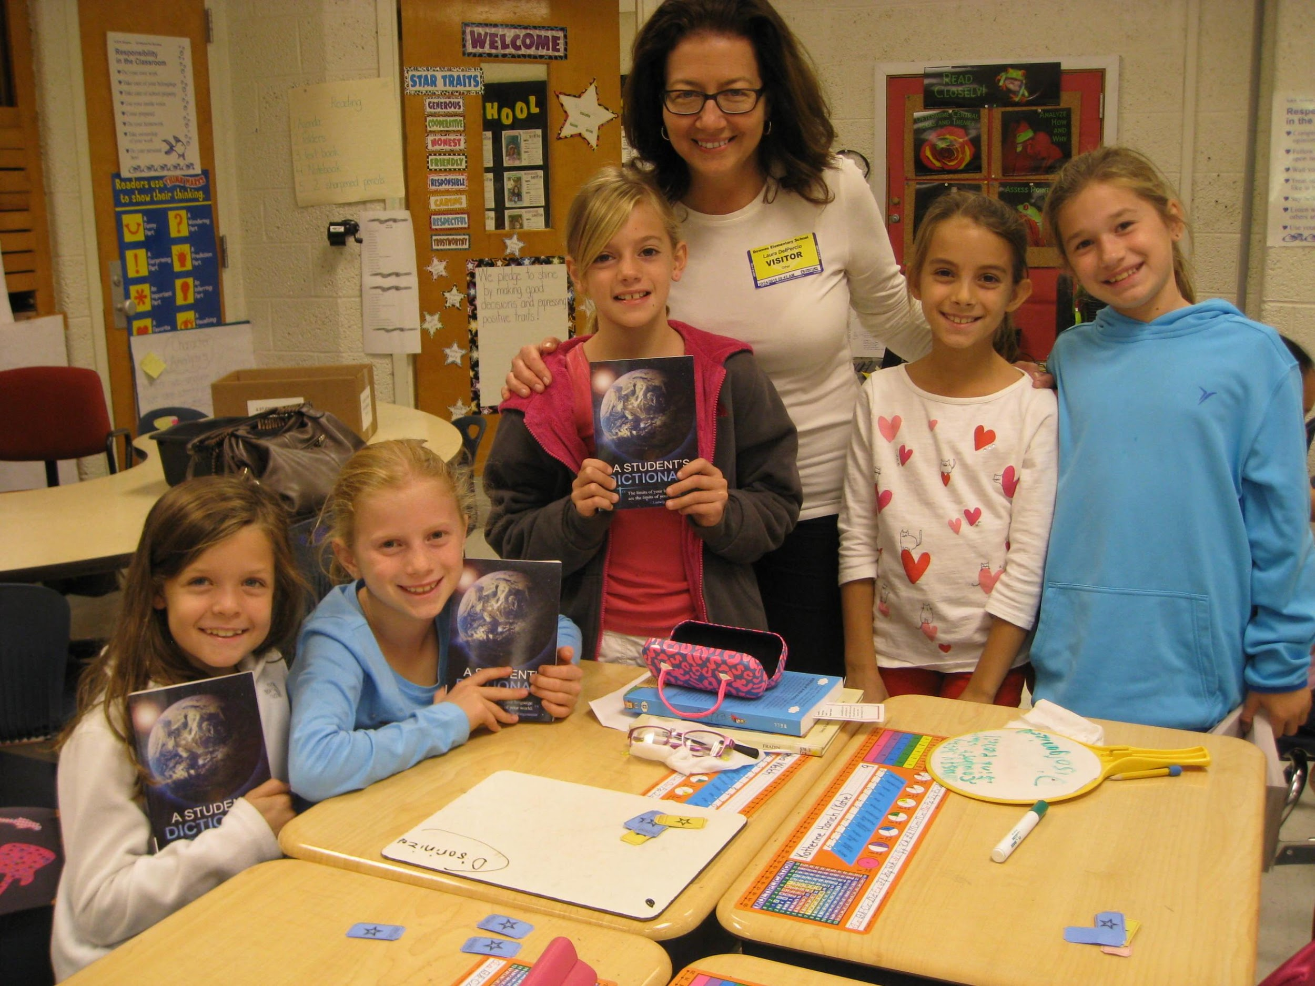
Is This for Me?
Can you see yourself doing this?

Slide 25
Is This for Me?
Why did we become Rotarians?
For the opportunity to help others
For fellowship and fun
To develop professional relationships

Slide 26
Is This for Me?
Is this for you?
Join us for a meeting, and then ...
Answer for Yourself
Notes:
26

Slide 27
Is This for Me?
Questions??

Slide 28
Thank You for Attending!
Newark Morning Rotary
Discover Rotary Hour
November 2, 2022

